Slide 1
Identifying Potential Sites for Wetlands via Causality-based Data Imputation and Knowledge Transfer
Presenter: Yoonhyuk Choi

Slide 2




Project Overview
Wetlands
Agriculture/ Water quality
Water recharge
Data Science

Slide 3
Ongoing projects
Streamflow prediction
Missing water stream data imputation
Wetland identification
Water quality/quantity modeling simulation
Causal modeling and causal discovery
Causality aware domain disentanglement
Multi-variate spatiotemporal data analysis
Graph/network analysis
Causally-informed recommendation systems

Slide 4
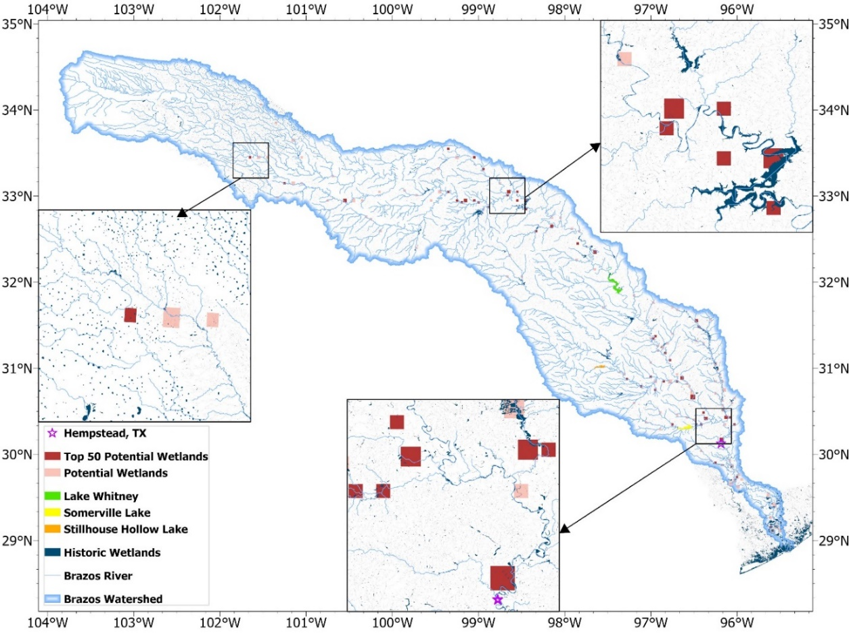
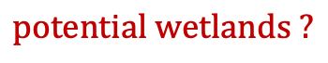
This presentation…
Brazos River
Wetlands
Agriculture/ Water quality
Water recharge
Data Science
Presenter: Yoonhyuk (Jim) Choi (Postdoc)
Paras Sheth (PhD Student)
Shu Wan (PhD Student)
Pratanu Mandal (PhD Student)
Kaize Ding (Asst. Prof.)
Huan Liu (Prof.)
K. Selcuk Candan (Prof.)
Wetlands
Reepal Shah (Research Scientist)
John Sabo (Prof.)
Data Science
$$potential wetlands ?$$

Slide 5
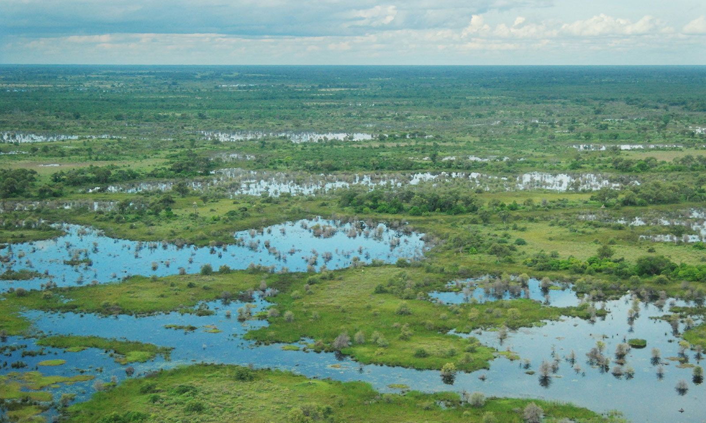
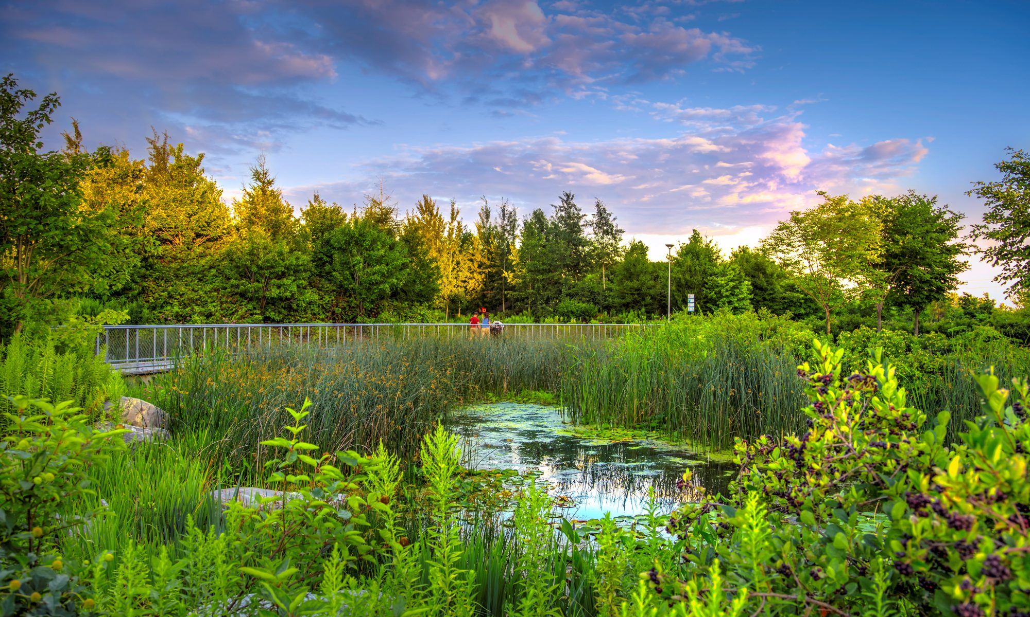
Wetlands
Definition
Water covers the soil
Present near the surface of the soil all year
Benefits
Floodwater storage
Retention, protection against storms and hurricanes, stabilization of shorelines
Water purification / Carbon fixation
Notes:
Providing a diverse spectrum of benefits
Wetlands are important features in the landscape that provide numerous beneficial services for people and for fish and wildlife. Some of these services, or functions, include protecting and improving water quality, providing fish and wildlife habitats, storing floodwaters and maintaining surface water flow during dry periods.

Slide 6
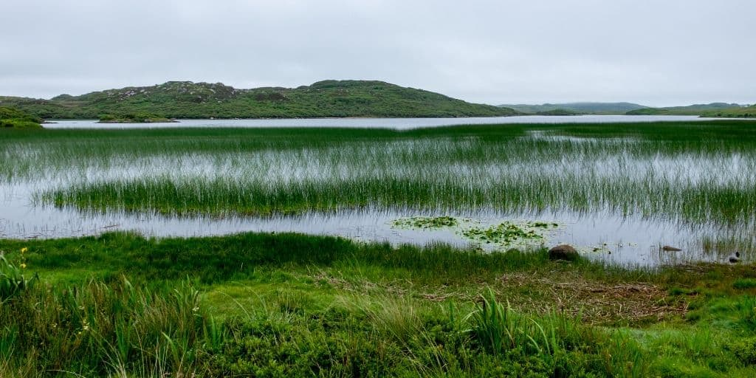
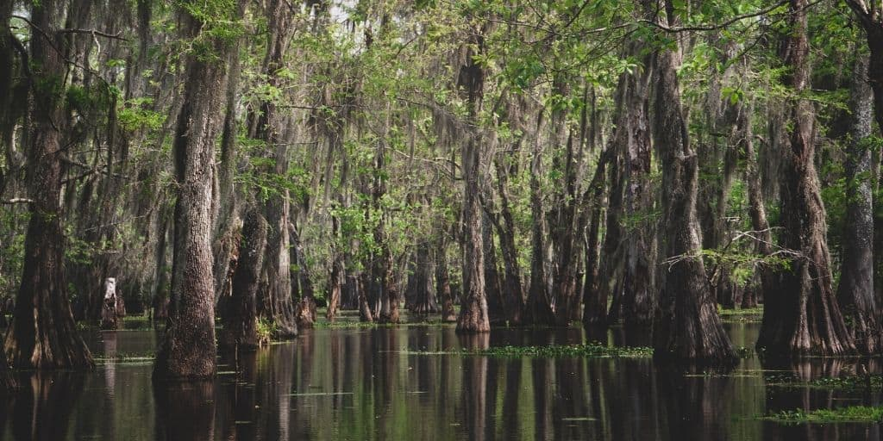
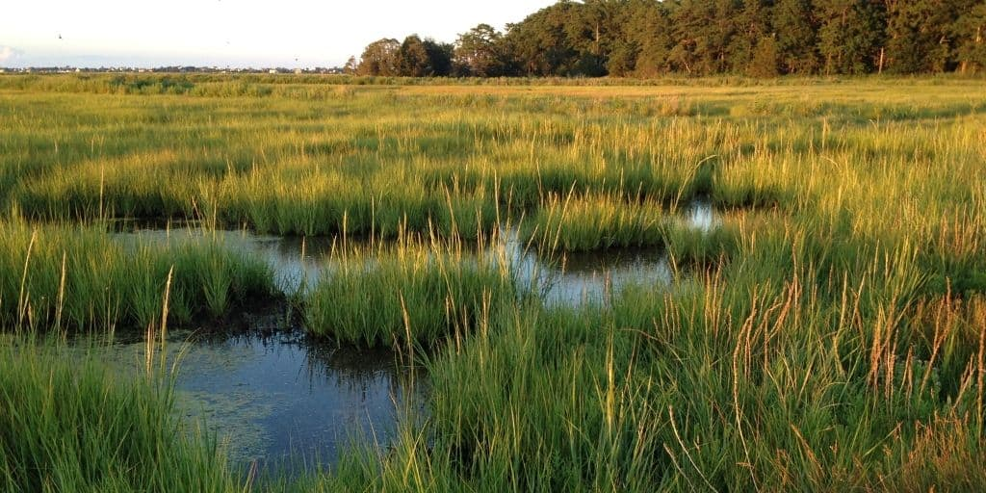
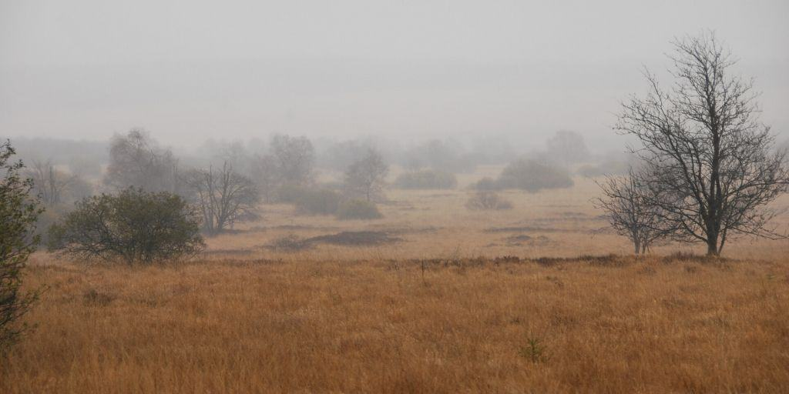
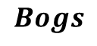
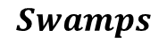
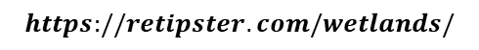
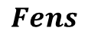

Type of Wetlands
$$Marshes$$
$$Swamps$$
$$Bogs$$
$$Fens$$
$$https://retipster.com/wetlands/$$
Notes:
Marshes This type of wetland is often populated by soft-stemmed plants (e.g. – grasses, rushes or reeds) and situated alongside lakes and streams. Marshes function as a transition point between the aquatic and terrestrial ecosystems.
Swamps and other wetlands have traditionally held a very low property value compared to fields, prairies, or woodlands. They have a reputation for being unproductive land that cannot easily be utilized for human activities, other than perhaps hunting and trapping
Bogs are freshwater wetlands, often formed in old glacial lakes, characterized by spongy peat deposits, evergreen trees and shrubs, and a floor covered by a thick carpet of sphagnum moss.
Fens are freshwater peat-forming wetlands covered mostly by grasses, sedges, reeds, and wildflowers. (source) They may also occur along large lakes and rivers where seasonal changes in water level maintain wet soils with few woody plants.

Slide 7
Wetland Identification
Prioritizing potential wetlands using various datasets,
National Land Cover Database (NLCD)
Soil Survey Geographic Database (SSURGO)
Height Above Nearest Drainage (HAND)
Identification for multiple downstream tasks
flood risk reduction
water storage enhancement

Slide 8
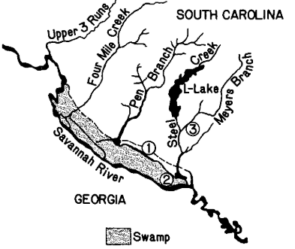
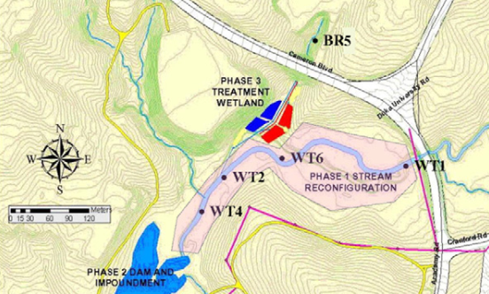


Wetland Identification (traditional)
Traditional techniques
Primarily depend on domain expertise
Especially difficult considering the heterogeneous nature of wetlands
$$Wetland identification in seasonally flooded forest soils (1993)$$
$$\text{Integrated} \text{stream} \text{and} \text{wetland} \text{restoration}\text{ (2011)}$$

Slide 9
Wetland Identification (recent)
Decision process assessing various parameters
Land use type, soil types, water table depth, potential evapotranspiration
Ground image can also be used
Land Features
Drainage/Flood
Soil
HAND Layer
Neural
Networks
Wetland Probability

Slide 10
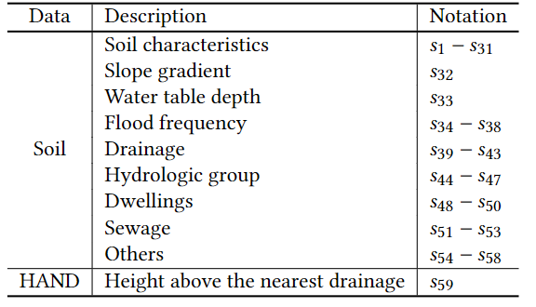
Wetland Identification (Our Approach)
We leverage the following data for wetland prioritization:

Slide 11
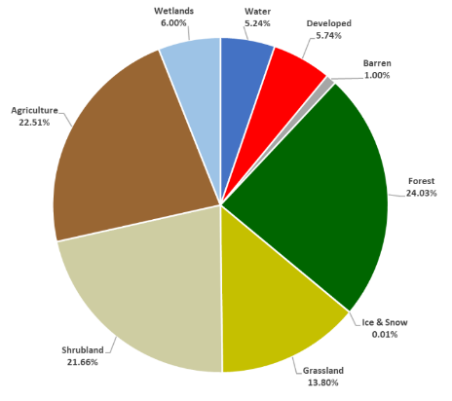
Challenges – data sparsity
Wetlands are rare!
Only 6% of land cover
They are even rare in dry regions
Arizona: 0.57%
Texas: 0.11%
NLCD 2016

Slide 12
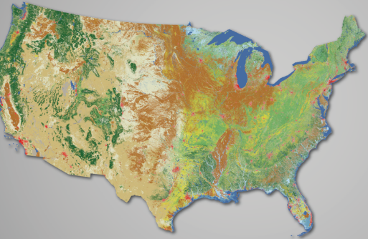
Challenge - context incompatibility
While knowledge transfer from one region to another is can tackle data sparseness
However, regional contexts may be highly incompatible
What: different soil characteristics, reservoirs, rainfall
Why: storage vs. flood prevention vs. purification
Few
Wetlands
Plentiful
Wetland

Slide 13
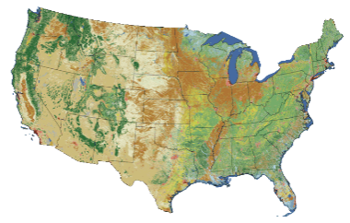
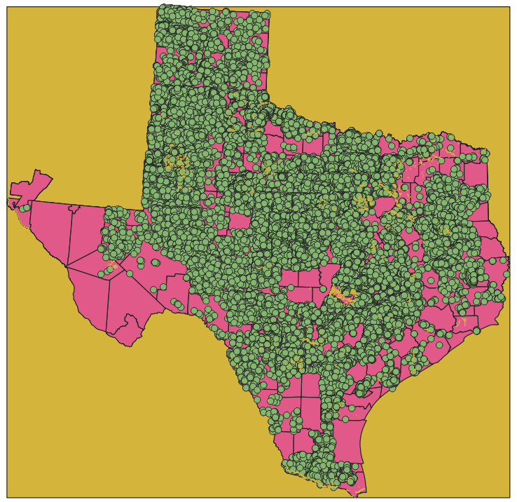
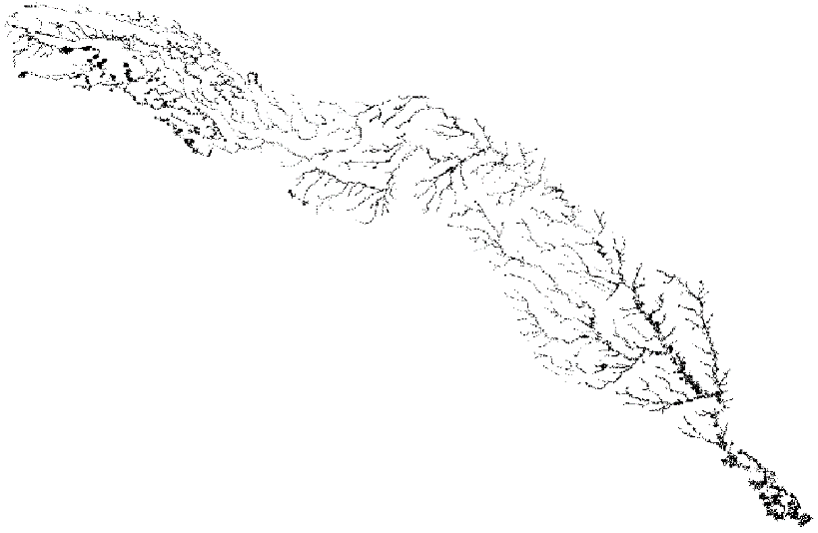
Challenge - scale incompatibility
Resolutions of the feature datasets (e.g. Hand layer) may differ from the resolutions of the of the available wetland data
NLCD (Wetland)
Soil (Flood/Drainage) Dataset
Hand Layer Dataset
Feature Datasets

Slide 14
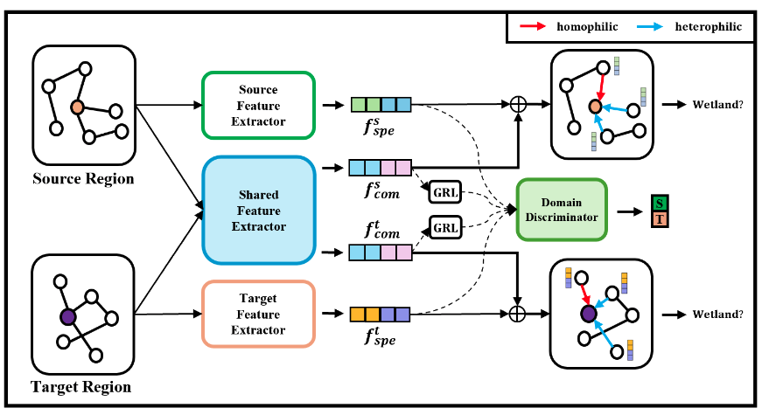
Our approach -- domain disentanglement
Knowledge transfer with domain disentanglement
Separate transferable knowledge from non-transferable knowledge
Gradient Reversal Layer (GRL) increases the entropy between features

Slide 15
Our approach -- Spatially informed data imputation
Enrich data relying on adjacent cells
Challenge: not all edges are homophilic!
Adaptive propagation: discover when information can be propagated based on local features.

Slide 16
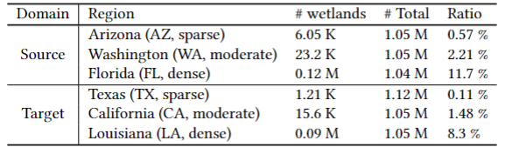
Experimental Setting
Identifying Potential Sites for Wetlands
Especially in sparse domains (e.g., Arizona and Texas)
Knowledge transfer from richer domains to the sparse ones
E.g., Florida to Texas
Statistics of datasets

Slide 17
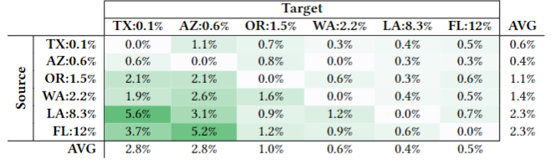
Experimental Results
Performance improvement after knowledge transfer

Slide 18
Thank you
Securing the Future of CRITICAL Engineered Natural Systems through DATA-and MODEL-DRIVEN RESILIENCE necessitates novel frameworks built on computational advances in
Big data and model integration
Causal learning and discovery
Large scale data- and model-driven simulations, emulations, and forecasting
Data-driven and model centric operational recommendations
Effective visualization and explanation

Slide 19
Data Science Team
K. Selcuk Candan (Prof.)
Huan Liu (Prof.)
Kaize Ding (Asst. Prof.)
Bilgehan Arslan (Asst. Prof.)
Presenter: Yoonhyuk (Jim) Choi (Postdoc)
Paras Sheth (PhD Student)
Pratanu Mandal (PhD Student)
Shu Wan (PhD Student)
Ahmet Kapkic (PhD Student)
and collaborators from other PMPs

